Slide 1

Msc. Data Science Applied Machine Learning Capstone Project
Mortality Prediction In Patients With Acute Kidney Injury (AKI)
Link to colab: https://colab.research.google.com/drive/1pyeVFrx4ISuciS4riEwRkuN1Mta82LTW
G r o u p N M e m b e r s :
-
Kevin Obote – 190696
Alex Gikaru - 168952
Adeline Makokha - 191199
Kennedy Mwenda - 193443
-

Slide 2
Introduction and Objectives
Introduction: Acute Kidney Injury (AKI) is a critical condition commonly observed in ICU patients, with significant implications for in- hospital mortality. This project aims to leverage clinical data to predict mortality outcomes, enabling improved decision-making and resource allocation in intensive care units.
Objectives
To develop a robust predictive model to accurately estimate in-hospital mortality for ICU patients diagnosed with Acute Kidney Injury (AKI)
To identify and prioritize key clinical variables that significantly influence mortality outcomes, supporting early intervention strategies.
To enhance understanding of AKI trajectories, to aid clinicians in resource allocation and personalized patient care.
To provide a foundation for integrating predictive analytics into ICU decision-making processes to improve patient outcomes.
About the dataset
The dataset is sourced from the MIMIC-III database, a publicly available repository of de-identified health data from ICU patients. It includes detailed clinical variables capturing the progression of AKI in the ICU, such as vital signs, laboratory results, medication use, and comorbidities.
The target variable, in-hospital mortality (IMH), is binary (1 = mortality, 0 = survival), enabling the development of classification models to predict outcomes based on patient trajectories.
2

Slide 3



Key variables
Description of key variables in the data
Age & Sex: Demographic information providing essential context for understanding patient profiles and their potential impact on mortality risk.
Days in ICU: The duration of a patient’s stay ing the ICU, reflecting the severity and
progression of their condition.
BP & HR: Blood pressure and heart rate, vital indicators of cardiovascular stability and overall physiological status.
Temp & WBC: Body temperature and white blood cell count, offering insights into immune activity and the presence of systemic infections.
PaO2 & FiO2: Partial pressure of oxygen in arterial blood and fraction of inspired oxygen, critical metrics for assessing respiratory function and oxygenation efficiency.
Pot, Bic, Na: Levels of potassium, bicarbonate, and sodium, essential electrolytes for
maintaining cellular and organ function.
BUN & Bilirubin: Blood urea nitrogen and bilirubin levels, serving as markers of kidney and liver function, respectively.
GCS: Glasgow Coma Scale, a standardized tool for evaluating the level of consciousness and neurological status.
IMH: In-hospital mortality, the target variable for this analysis;
indicating survival (0) or
mortality (1) outcomes during the ICU stay.
3

Slide 4
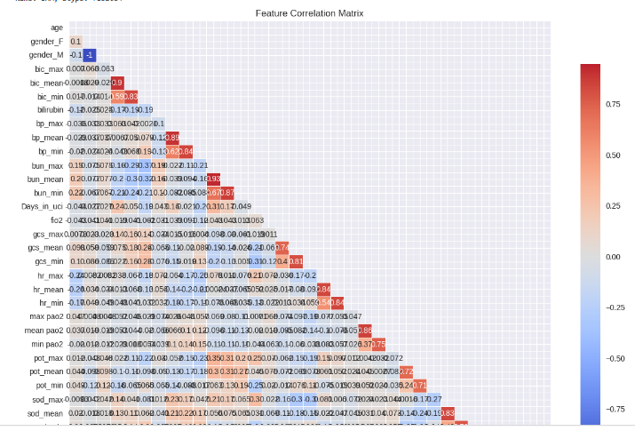
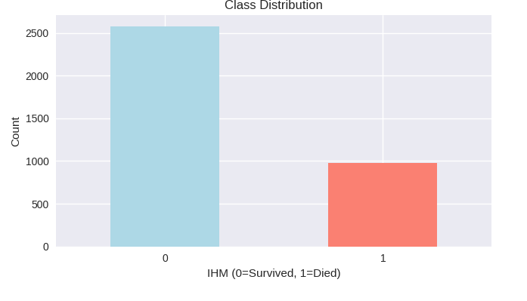
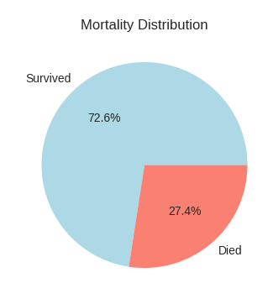
Exploratory data analysis
Aimed to understand the dataset’s structure, identify patterns, and prepare for modeling. Key clinical and demographic variables were analyzed for distributions to detect trends, outliers, and skewness. A correlation matrix highlighted relationships and multicollinearity, informing feature selection and engineering. This approach ensured a focus on relevant predictors, laying a solid foundation for preprocessing and predictive modeling
Target Variable Analysis
Correlation matrix
Aim: Visualize the distributions of Mortality
Observation: As expected, higher values for Days_in_uci, bun_max, and bun_mean are positively correlated with mortality. Conversely, higher gcs_min and gcs_mean (better consciousness) are negatively correlated with mortality. This aligns with clinical intuition
4

Slide 5

Data Preprocessing
Preprocessing steps taken
Handling Missing Values: Median imputation was applied to ensure robustness and avoid data loss.
Handling Outliers: May represent critical medical conditions
Feature Scaling: Important for algorithms sensitive to scale
Handling Class Imbalance: Critical in medical prediction tasks
Feature Engineering- key highlight
The PaO2/FiO2 Ratio was introduced to enhance the model's predictive power by providing a nuanced measure of oxygenation efficiency in the lungs. As a key marker of respiratory function, it combines PaO2 and FiO2 to assess conditions like Acute Respiratory Distress Syndrome (ARDS) and improve insights into respiratory health, ultimately aiding in more accurate prediction of patient outcomes. It reflects the efficiency of oxygen transfer in the lungs.
By integrating this ratio, the model gains a feature that directly correlates with key clinical outcomes, enabling it to detect subtle patterns and variations in oxygenation that may signal worsening or improving conditions.
5

Slide 6
Multiple Algorithm Approach
We trained multiple algorithms to find the best performer:
Logistic Regression: Interpretable baseline
Random Forest: Ensemble method, handles non-linearity
Gradient Boosting: Advanced ensemble technique
Support Vector Machine: Effective for high-dimensional data
K-Nearest Neighbors: Instance-based learning
Naive Bayes: Probabilistic classifier
Deep Neural Network: Captures complex patterns

Slide 7
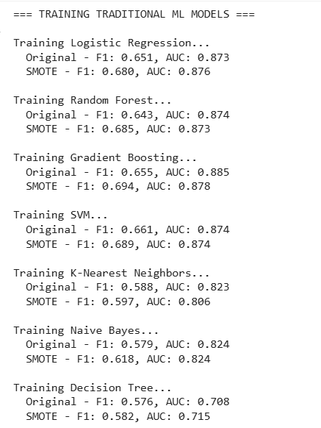
MODELS AND THEIR PERFORMANCE
Gradient Boosting achieved the highest AUC (0.885) on the original data and remained strong after SMOTE.
SMOTE generally improved the F1 score across models, confirming that balancing the dataset helped minority class recognition.
Decision Tree and KNN performed weakest in AUC, indicating limited discriminative power.
8

Slide 8
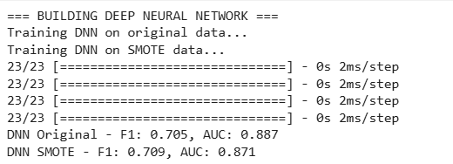
Deep Neural Network (DNN)
The Deep Neural Network (DNN) shows an F1 score of around 0.70 in both cases, indicating a strong balance between precision and recall.
The AUC of 0.887 on the original data suggests that the model has a high ability to discriminate between the positive and negative classes.
After applying SMOTE, the F1 score improves slightly (0.705 → 0.709), showing that class balancing helped the model identify the minority class better.
However, AUC decreases slightly (0.887 → 0.871) — a common occurrence because SMOTE can sometimes introduce synthetic noise, slightly reducing the model’s overall discriminatory power.
9

Slide 9
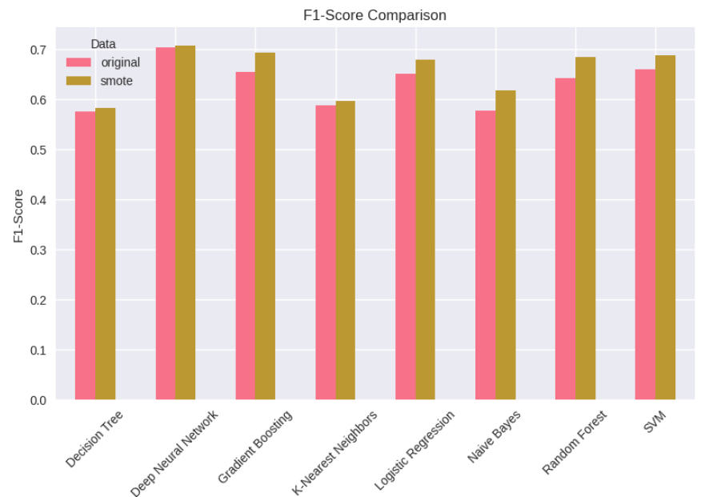
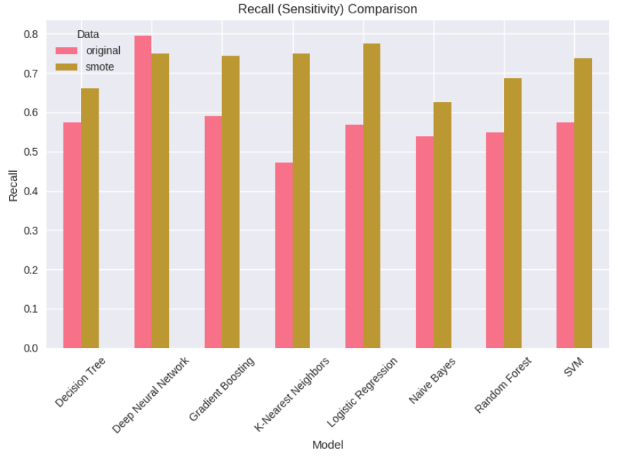
MODEL COMPARISON
SMOTE (Synthetic Minority Oversampling Technique) effectively improved class balance, allowing models to better capture minority class patterns.
Deep learning and ensemble models (DNN, Gradient Boosting, Random Forest) show the best adaptability to balanced data.
Simpler models benefit but remain less powerful in complex feature spaces.
SMOTE (Synthetic Minority Over-sampling Technique) enhanced class balance, leading to better F1 performance across all models.
Deep Neural Network, followed by Gradient Boosting and Random Forest, achieved the best trade-off between precision and recall, making them ideal candidates for production deployment in this classification task.
The chart clearly demonstrates that addressing data imbalance is critical to improving model reliability and fairness.

Slide 10
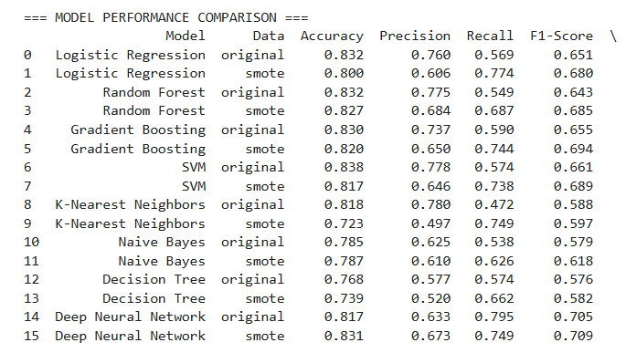
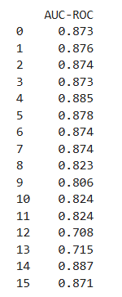
MODEL COMPARISON
Deep Neural Network achieved the best overall balance — highest F1 (0.709) and AUC (0.887 before SMOTE), showing strong predictive power and generalization.
Gradient Boosting and Random Forest followed closely, performing robustly on the datasets.
SMOTE effectively improved recall and F1, validating the importance of class balance in imbalanced classification tasks.

Slide 11

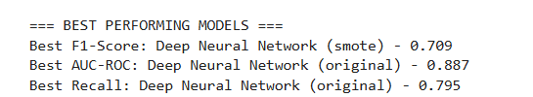
BEST PERFORMING MODELS
The Deep Neural Network clearly outperformed all traditional machine learning models across major metrics.
SMOTE improved F1 slightly, helping balance predictions between precision and recall.
However, the original dataset version of the DNN maintained the best AUC and recall, showing it generalized well without needing synthetic samples.

Slide 12
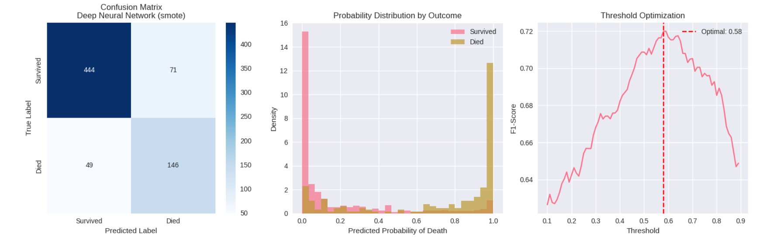
The two distributions are well-separated, meaning the model effectively differentiates between survivors and deaths.
Only a small overlap occurs in the middle (around 0.4–0.6), where predictions are uncertain.
FINAL MODELS AND THEIR PERFORMANCE
The model correctly classified 444 survivors and 146 deaths.
It made 71 false positives (predicted “died” but actually survived) and 49 false negatives (predicted “survived” but actually died).
These are good results, showing a strong balance between sensitivity and specificity.
Model Strength: High true positive and true negative rates. Model Weakness: Some confusion between the two classes — mainly in predicting “died” cases.
The default threshold (0.5) is not necessarily optimal; at 0.58, the model achieves the highest F1 (~0.71).
This means setting the cutoff slightly higher improves the trade-off between precision and recall, reducing false positives while maintaining good sensitivity.

Slide 13
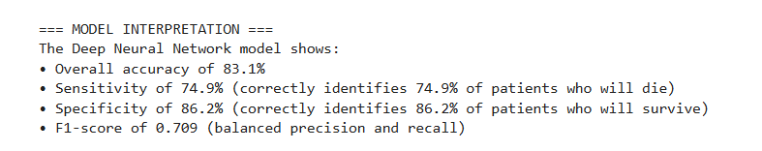
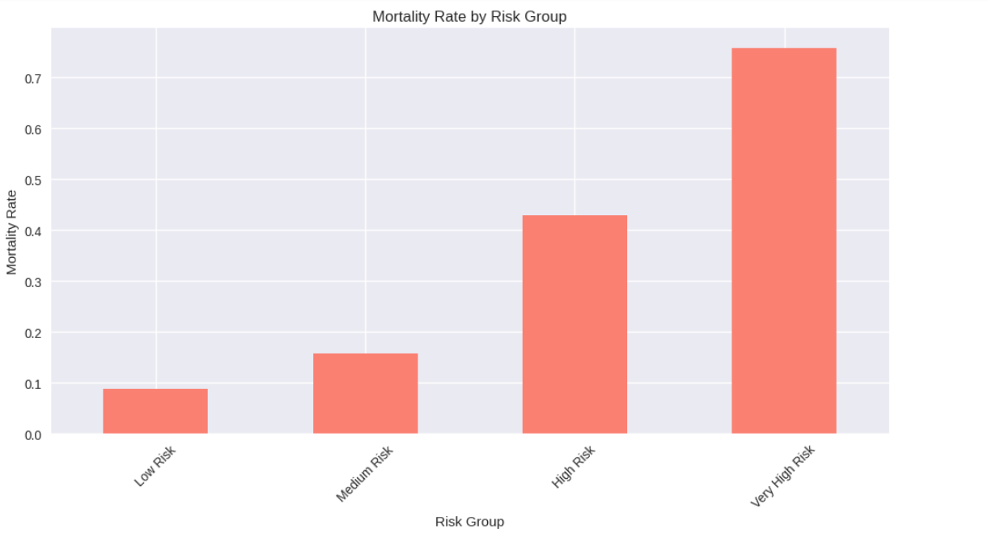
Clinical Insights and Feature Analysis
The model demonstrates excellent discriminative ability: it is sensitive enough to detect most at-risk patients while maintaining high specificity for survivors.
The F1-score of 0.709 shows a good balance between false positives (predicting death when alive) and false negatives (predicting survival when death occurs).
These metrics, combined with the risk group chart, confirm that the DNN not only predicts outcomes correctly but also ranks patients’ mortality risk realistically.

Slide 14
SAVING THE BEST MODEL
The Deep Neural Network (DNN) achieved the highest performance (F1 = 0.709, AUC = 0.887).
This model was selected as the final production model due to its superior balance between precision and recall.Deep Neural Network (DNN):
Method: `joblib.dump(best_dnn_model, "best_dnn_model.pkl")`.
File Format: Pickle (`.pkl`).
Library: `joblib` is lightweight and efficient for serializing Python objects, especially tree- based models.
Reloading: Use `joblib.load("best_dnn_model.pkl")` to restore the model.
Advantages of Model Serialization:
Portability: Enables moving models across environments (e.g., development to production).
Efficiency: Saves time by avoiding retraining.
Scalability: Facilitates deployment in real-world applications.

Slide 15
Imbalanced Dataset: The “died” class had far fewer observations compared to the “survived” class, leading models to favor the majority class.
Data Quality Issues: Missing, noisy, or inconsistent patient records (e.g., missing lab values, categorical inconsistencies) can reduce predictive accuracy.
Feature Redundancy or Irrelevance: Some features might not contribute meaningfully to predicting mortality, creating noise in training.
Small Dataset Size: Deep Neural Networks typically need large datasets to generalize well; limited data can lead to overfitting.
Challenges
SOLUTIONS
ADOPTED

Slide 16
To overcome the challenges, several strategies were implemented:
Balancing Techniques: Used SMOTE (Synthetic Minority Oversampling Technique) to generate synthetic examples of minority cases and improve minority-class recall.
Data Cleaning & Imputation: Applied preprocessing steps to handle missing values, remove duplicates, and standardize features.
Feature Selection/Engineering: Used correlation checks, domain knowledge, and feature importance analysis to select the most relevant variables.
Regularization & Dropout: Added dropout layers and L2 regularization in the DNN to mitigate overfitting due to limited samples.
SOLUTIONS ADAPTED
SOLUTIONS
ADOPTED

Slide 17
Developed a robust mortality prediction model using traditional ML and Deep Neural Networks (DNN).
The DNN (with SMOTE) achieved the best overall performance — Accuracy: 83.1% | F1: 0.709 | AUC: 0.887 | Sensitivity: 74.9% | Specificity: 86.2%.
SMOTE improved class balance and recall for minority (death) cases.
Risk stratification clearly separated patients into Low, Medium, High, and Very-High mortality groups.
Visual tools (confusion matrix, probability plots, threshold tuning) enhanced model interpretability and clinical relevance.
Conclusion
SOLUTIONS
ADOPTED

Slide 18
External Validation: Test the model on independent hospital datasets to confirm generalizability.
Model Deployment: Build an interactive dashboard or API for real-time risk prediction.
Continuous Learning: Implement model retraining pipelines to update predictions as new data arrive.
Ethical Oversight: Monitor for bias, ensure fairness across demographic groups, and maintain data privacy compliance.
Future Works & Recommendations
SOLUTIONS
ADOPTED

Slide 19
• Alex Gikaru – Introduction and Objectives (Overview of the project and dataset), EDA, Data preprocessing
• Kevin Obote – Model development & tuning
• Kennedy Mwenda – Evaluation & visualization
• Adeline Makokha – Challenges and Solutions, Conclusion
MEMBER CONTRIBUTIONS
SOLUTIONS
ADOPTED

